Slide 2
Reaching the Unreachable: Early Results from Index Testing in Zambia in the CIRKUITS Project
Linah K. Mwango RN, HNP, BSc. Nrs
Deputy Chief of Party
Share your thoughts on this presentation with #IAS2019

Slide 3
Conflicts of Interest
No conflicts of interest to declare

Slide 4
Zambia HIV Incidence & Prevalence (15-59 Years)
Annual adults HIV incidence: 0.61%
~ 43,000 new infections per year
Adult HIV Prevalence: 12.0%
~ 960,000 PLHIV
HIV prevalence in 20-24 years:
4 times higher among females (8.3%) than among males (2.0%)
Men and adolescents are priority populations and hard to reach for HTS

Slide 5
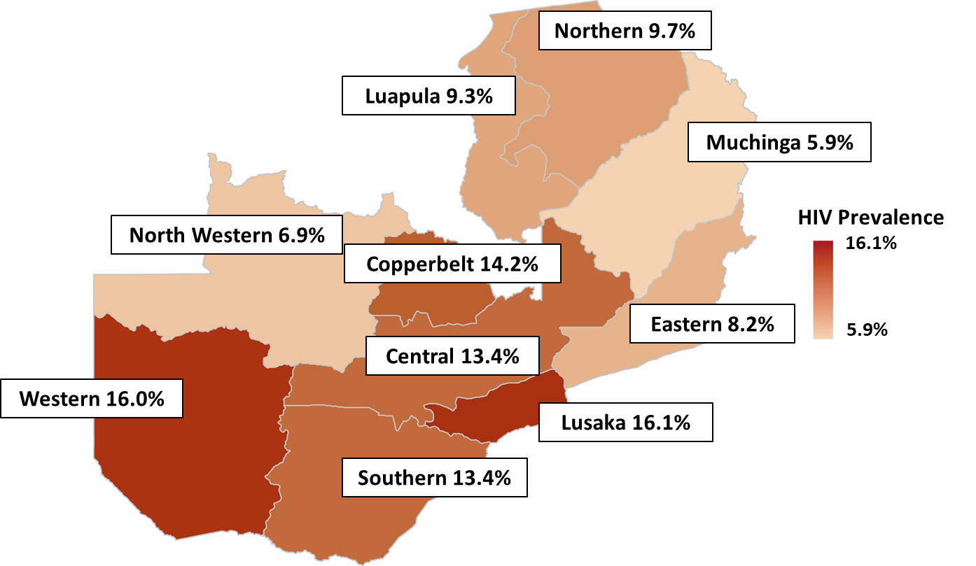
CIRKUITS Target Provinces
CIRKUITS is PEPFAR funded through CDC
Aim: close the testing gap through targeted community testing to reach PPs & KPs in Zambias high HIV burden provinces
Men
AGYW
Peds & PBFW
KPs
Epidemic Control goals: 67% - 85% - 89%

Slide 6
Background of Index Testing and Partner Notification Services (IT & PNS) in Zambia
Following the PHIA results, IT & PNS were introduced in 2017 to improve HIV case identification
Initially IT & PNS were focused on testing children & spouses (index family tree testing)
Targeted testing of other sexual contacts was then included in the 2018 National Guidelines
Mentorship and data collecting tools were developed
ZCG-Jan 2018

Slide 7
Social Network and Index Testing Strategies
To reach the unreachable populations CIRKUITS uses a two prong approach:
Social Network testing Strategy (SNS): high risk individuals are recruited, tested and those positive are subsequently elicited for contacts
Index HIV testing and partner notification services
Social Network and Index Testing Strategy

Slide 8
OFFERED HIV TESTING
POSITIVE CONTACTS OF SNS OFFERED IT & PNS
Negative Contact
SNS
IT & PNS
Positive Contact
Negative Contacts
High Risk Individual (HRI)
Negative/Positive Contact, Recruiter
Social Network and Index Testing Strategy
Positive Contacts
Identify New Networks

Slide 9
Methodology
21 Community liaison officers and 157 lay counselors were recruited, trained and deployed to offer index testing
Index clients identified through SNS or clients in ART care
All HIV+ (Index Clients) offered IT & PNS
Elicitation of HIV exposed sexual partners & children (<15yrs)
Active follow up of partners through partner or client referral

Slide 10
Overall Index Testing Results Oct 18 – Jun 19
15626
12045
Proportions of Positives
W>25: 41%
M>25: 36%
AGYW: 15%
ABYM: 5%
<10: 3%
3581
Unknown
HIV
Status not reached
9651
8997
New HIV +
3575
Linkage to ART: 84%

Slide 11
Adolescents & Young People Index Testing Services (Oct18-Jun19)
Adolescents and Young People (10-24yrs)

Slide 12
Men Index Testing services (Oct18-Jun19)
Men (25-50 years)

Slide 13
Lessons Learnt
Finding men: Index contact elicitation from AGYWs facilitates HTS among their partners (older men & ABYM)
Index testing is a targeted modality; testing a few and finding more positives
Constant mentorship of counselors in elicitation skills improves the elicitation ratios
Real time data collection using customized DHIS2 for community HTS improves performance tracking
Active tracking of index contacts assists in finding other priority populations:
Known HIV+ clients not yet linked to care
Known HIV+ clients who are LTFU; can be re-engaged into care

Slide 14
Challenges and Solutions
Attrition and turn-over of lay counselors
Continued re-orientations, hand-holding mentorship, incentives to support community work (bikes, rain gear, etc.)
Failure to track some index contacts between distant CIRKUITS operational areas (inter-provincial/district)
Transfer details of index contacts to other operational areas for follow up
Provide extra transport requirements including hire of extra vehicles, and stipends for after-hours/weekend services
Inconsistent performance (elicitation, yields, linkage) among lay counselors
Daily and weekly “situation room” to monitor facility performances
Real time data reviews to track performances
Individual score cards, reviewed weekly to monitor lay counselors

Slide 15
Limitations
Lack of follow-up of index contacts that are outside the CIRKUITS operational catchment areas contributes to 23% of index contacts not being reachable for HTS

Slide 16
Conclusions
Co-implementing index testing and social networking strategy leads to high yields of positives among hard-to-reach populations
Men – 41%, adolescents – 32%, and children – 8%
Index testing is a strategy that improves HIV case identification among the previously unreached populations
Index and social networking strategies need to be scaled up to achieve epidemic control
IT & PNS facilitate known positives not on treatment being linked to ART

Slide 17
Acknowledgments

